Slide 1
Advanced Dungeons and Testing Dragons
Temple of the Golden Cobra

Slide 2

Franklin Webber
Training and Technical Content Lead
US Army - Radio/COMSEC Repairer (35E)
Tech Support
Quality Assurance
Software Developer Eng. in Test
Software Developer
Instructor / Trainer
Notes:
Before we start let me introduce myself.

Slide 3
Dan
"Two Swords" Robinson
Eric
"BB / LG" Maxwell
Kimball
"Magic Missile" Johnson
Tyler
"Cure Light Wounds"
Fitch

Slide 4
You
Level 4-6 Chef Cookbook Author
High Charisma
Understand Chef Resources, Cookbooks, and Cookbook dependencies
Understanding testing basics (i.e. ChefSpec and the RSpec command)
Notes:
Let me tell who I think you are and for whom this content has been designed.

Slide 5
Introduce Yourself

Slide 6
Schedule
9:00 - 9:30 – Introductions
9:30 - 10:15 – Finding the Ark
10:15 - 10:30 – BREAK
10:30 - 11:15 – Unraveling the Power of the Ark
11:15 - 11:30 – BREAK
11:30 - 12:15 – The Ark's Power Realized
12:15 - 13:45 – LUNCH (90 minutes)
Notes:
This is the general schedule of the presentation.

Slide 7
Schedule
12:15 - 13:45 – LUNCH (90 minutes)
13:45 - 14:15 – The Python's Scales
14:15 - 14:30 – BREAK
14:30 - 15:15 – Challenging the Golden Cobra
15:15 - 15:30 – BREAK
15:30 - 16:15 – Securing the Power of the Ark
16:15 - 16:30 – GOODBYES
Notes:
This is the general schedule of the presentation.

Slide 8
Advanced Dungeons and Testing Dragons
Temple of the Golden Cobra

Slide 9
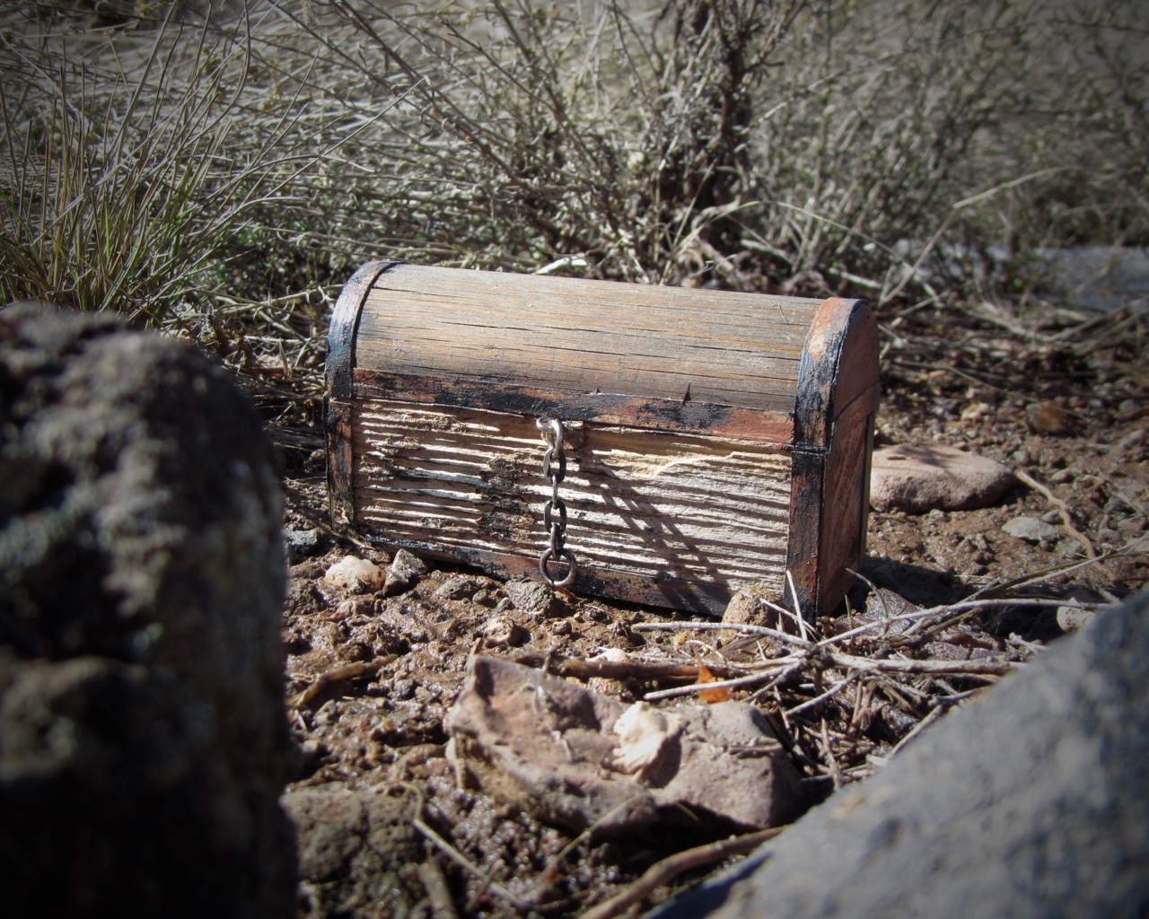
Finding the Ark
The Story so Far
The Encounter
Concepts
Exercise
Review
Notes:
davidd @ https://flic.kr/p/DyTeW1

Slide 11
Finding the Ark
The Story so Far
The Encounter
Concepts
Exercise
Review

Slide 13
Finding the Ark
The Story so Far
The Encounter
Concepts
Exercise
Review

Slide 14
Power Word: let
Use let to define a memoized helper method. The value will be cached
across multiple calls in the same example but not across examples.
Note that let is lazy-evaluated: it is not evaluated until the first time
the method it defines is invoked. You can use let! to force the method's
invocation before each example.
https://goo.gl/BJp0IQ

Slide 15
Diagramming the let Helper Method
describe 'ark::default' do
context 'when no attributes are ...
let(:chef_run) do
runner = ChefSpec::SoloRunner.new
runner.converge(described_recipe)
runner
end
it 'installs necessary packages' do
expect(chef_run).to install_p...
expect(chef_run).to install_p...
end
it "does not install the gcc-c+...
expect(chef_run).not_to insta...
end
let is a RSpec helper method
Ruby Symbol
Code Block
Invocation

Slide 16
Invoking the Helper Method
describe 'ark::default' do
context 'when no attributes are ...
let(:chef_run) do
runner = ChefSpec::SoloRunner.new
runner.converge(described_recipe)
runner
end
it 'installs necessary packages' do
expect(chef_run).to install_p...
expect(chef_run).to install_p...
end
it "does not install the gcc-c+...
expect(chef_run).not_to insta...
end
chef_run sends a message
RSpec invokes the contents of the block
RSpec stores the contents of the execution
chef_run sends a message
RSpec retrieves the stored execution

Slide 17
Cached Within each Example
describe 'ark::default' do
context 'when no attributes are ...
let(:chef_run) do
runner = ChefSpec::SoloRunner.new
runner.converge(described_recipe)
runner
end
it 'installs necessary packages' do
expect(chef_run).to install_p...
expect(chef_run).to install_p...
end
it "does not install the gcc-c+...
expect(chef_run).not_to insta...
end
chef_run is loaded and stored
chef_run uses the stored invocation
chef_run is loaded and stored

Slide 18
A chef_run with Node Attributes
describe 'ark::default' do
context 'when no attributes are specified, on CentOS' do
let(:chef_run) do
runner = ChefSpec::SoloRunner.new({ platform: 'centos',
version: '6.7' })
runner.converge(described_recipe)
end
# ... EXAMPLES WITHIN CONTEXT
end
end

Slide 19
Using let to Create Clearer Examples
describe 'ark::default' do
context 'when no attributes are specified, on CentOS' do
let(:chef_run) do
runner = ChefSpec::SoloRunner.new(node_attributes)
runner.converge(described_recipe)
end
let(:node_attributes) do
{ platform: 'centos', version: '6.7' }
end
# ... EXAMPLES WITHIN CONTEXT
end

Slide 20
A let for each Context
describe 'ark::default' do
context 'when no attributes are specified, on an unspe...orm' do
let(:chef_run) do
runner = ChefSpec::SoloRunner.new
runner.converge(described_recipe)
end
# ... EXAMPLES WITHIN CONTEXT
end
context 'when no attributes are specified, on CentOS' do
let(:chef_run) do
runner = ChefSpec::SoloRunner.new(platform: 'centos', version: ...)
runner.converge(described_recipe)
end
# ... EXAMPLES WITHIN CONTEXT

Slide 21
Overriding a let in a Child Context
describe 'ark::default' do
let(:chef_run) do
runner = ChefSpec::SoloRunner.new(node_attributes)
runner.converge(described_recipe)
end
let(:node_attributes) do
{}
end
context 'when no attributes are specified, on an unspecif...orm' do
# ... EXAMPLES WITHIN CONTEXT
end
context 'when no attributes are specified, on CentOS' do
let(:node_attributes) do
{ platform: 'centos', version: '6.7' }
end
# ... EXAMPLES WITHIN CONTEXT

Slide 22
Conjure shared_examples
Shared examples let you describe behavior of classes or modules. When declared, a shared group's content is stored. It is only realized in the context of another example group, which provides any context the shared group needs to run.
https://goo.gl/yi12tM

Slide 23
Finding the Ark
The Story so Far
The Encounter
Concepts
Exercise
Review

Slide 24
Exercise
Refactor the the Ark's default recipe specification using:
Power Word: let
Conjure: shared_examples
Run `chef exec rspec spec/recipes/default_spec.rb` to ensure the examples pass

Slide 25
Finding the Ark
The Story so Far
The Encounter
Concepts
Exercise
Review

Slide 26
Change in to the Cookbook Directory
> cd ~/ark

Slide 27
Execute the Test Suite
> chef exec rspec spec/recipes/default_spec.rb
...................
Finished in 3.58 seconds (files took 2.73 seconds to load)
19 examples, 0 failures
ChefSpec Coverage report generated...
Total Resources: 41
Touched Resources: 41
Touch Coverage: 100.0%

Slide 28
Edit the Recipe Specification File
~/ark/spec/recipes/default_spec.rb
require 'spec_helper'
describe 'ark::default' do
context 'when no attributes are specified, on an unspecified platform' do
let(:chef_run) do
runner = ChefSpec::SoloRunner.new
runner.converge(described_recipe)
end
it 'installs necessary packages' do

Slide 29
Live Demonstration

Slide 30
Finding the Ark
The Story so Far
The Encounter
Concepts
Exercise
Review

Slide 32

Unraveling the Power of the Ark
Introduction
The Encounter
Concepts
Exercise
Review
Notes:
Jeferson Carlos @ https://flic.kr/p/f7KDsW

Slide 34
Unraveling the Power of the Ark
Introduction
The Encounter
Concepts
Exercise
Review

Slide 36
Unraveling the Power of the Ark
Introduction
The Encounter
Concepts
Exercise
Review

Slide 37
Prismatic require
Loads the given name, returning true if successful and false if the feature is already loaded.
If the filename does not resolve to an absolute path, it will be searched for in the directories listed in $LOAD_PATH ($:).
http://goo.gl/cLKY37

Slide 38
Greater require_relative
Ruby tries to load the library named string relative to the requiring file's path. If the file's path cannot be determined a LoadError is raised. If a file is loaded true is returned and false otherwise.
http://goo.gl/Gv8QdI

Slide 39
Ray of shared_context
Use shared_context to define a block that will be evaluated in the context of example groups either explicitly, using include_context, or implicitly by matching metdata.
http://goo.gl/R0ujTA

Slide 40
alias_example_group_to
describe and context are the default aliases for example_group. You can define your own aliases for example_group and give those custom aliases default metadata.
http://goo.gl/DfUChL

Slide 41
Unraveling the Power of the Ark
Introduction
The Encounter
Concepts
Exercise
Review

Slide 42
Exercise
Continue to refactor the the Ark's default recipe specification using:
Power Word: let
Conjure shared_examples
Prismatic require
Ray of shared_context
alias_example_group_to
Run `chef exec rspec spec/recipes/default_spec.rb` to ensure the examples pass

Slide 43
Unraveling the Power of the Ark
Introduction
The Encounter
Concepts
Exercise
Review

Slide 44
Change in to the Cookbook Directory
> cd ~/ark

Slide 45
Execute the Test Suite
> chef exec rspec spec/recipes/default_spec.rb
...................
Finished in 3.58 seconds (files took 2.73 seconds to load)
19 examples, 0 failures
ChefSpec Coverage report generated...
Total Resources: 41
Touched Resources: 41
Touch Coverage: 100.0%

Slide 46
Edit the Recipe Specification File
~/ark/spec/recipes/default_spec.rb
require 'spec_helper'
describe 'ark::default' do
context 'when no attributes are specified, on an unspecified platform' do
let(:chef_run) do
runner = ChefSpec::SoloRunner.new
runner.converge(described_recipe)
end
it 'installs necessary packages' do

Slide 47
Live Demonstration

Slide 48
Unraveling the Power of the Ark
Introduction
The Encounter
Concepts
Exercise
Review

Slide 50

The Ark's Power Realized
Introduction
The Encounter
Concepts
Exercise
Review
Notes:
Nullfy from Nullfy.com! @ https://flic.kr/p/qC7Qhn

Slide 52
The Ark's Power Realized
Introduction
The Encounter
Concepts
Exercise
Review
Notes:
Nullfy from Nullfy.com! @ https://flic.kr/p/qC7Qhn

Slide 54
The Ark's Power Realized
Introduction
The Encounter
Concepts
Exercise
Review
Notes:
Nullfy from Nullfy.com! @ https://flic.kr/p/qC7Qhn

Slide 55
Fixture Cookbook
Defining a cookbook, within a cookbook's test directory, that employs the cookbook in the various ways in which it may be used by downstream cookbooks.
This is often to ensure test coverage for features not in the defined recipes and their associated tests. Common if you are building a cookbook that employs a custom resource.
http://goo.gl/?????

Slide 56
Defining ChefSpec Matchers
ChefSpec exposes the ability for cookbook authors to package custom matchers inside a cookbook so that other developers may take advantage of them in testing.
https://goo.gl/lSQDXD

Slide 57
ChefSpec's step_into
ChefSpec overrides all providers to take no action (otherwise it would actually converge your system). This means that the steps inside your custom resource are not actually executed. If a custom resource performs actions, those actions are never executed or added to the resource collection.
In order to run the actions exposed by your custom resource, you have to explicitly tell the Runner to step into it.
https://goo.gl/SKM4L3

Slide 58
The Ark's Power Realized
Introduction
The Encounter
Concepts
Exercise
Review
Notes:
Nullfy from Nullfy.com! @ https://flic.kr/p/qC7Qhn

Slide 59
Exercise
Define the 'install_with_make' example
Run `chef exec rspec spec/resources/default_spec.rb:57` to ensure the example passes

Slide 60
The Ark's Power Realized
Introduction
The Encounter
Concepts
Exercise
Review
Notes:
Nullfy from Nullfy.com! @ https://flic.kr/p/qC7Qhn

Slide 61
Change in to the Cookbook Directory
> cd ~/ark

Slide 62
Execute the Test Suite
> chef exec rspec spec/resources/default_spec.rb:57

Slide 63
Edit the Resource Specification File
~/ark/spec/resources/default_spec.rb

Slide 64
Live Demonstration

Slide 65
The Ark's Power Realized
Introduction
The Encounter
Concepts
Exercise
Review
Notes:
Nullfy from Nullfy.com! @ https://flic.kr/p/qC7Qhn

Slide 67
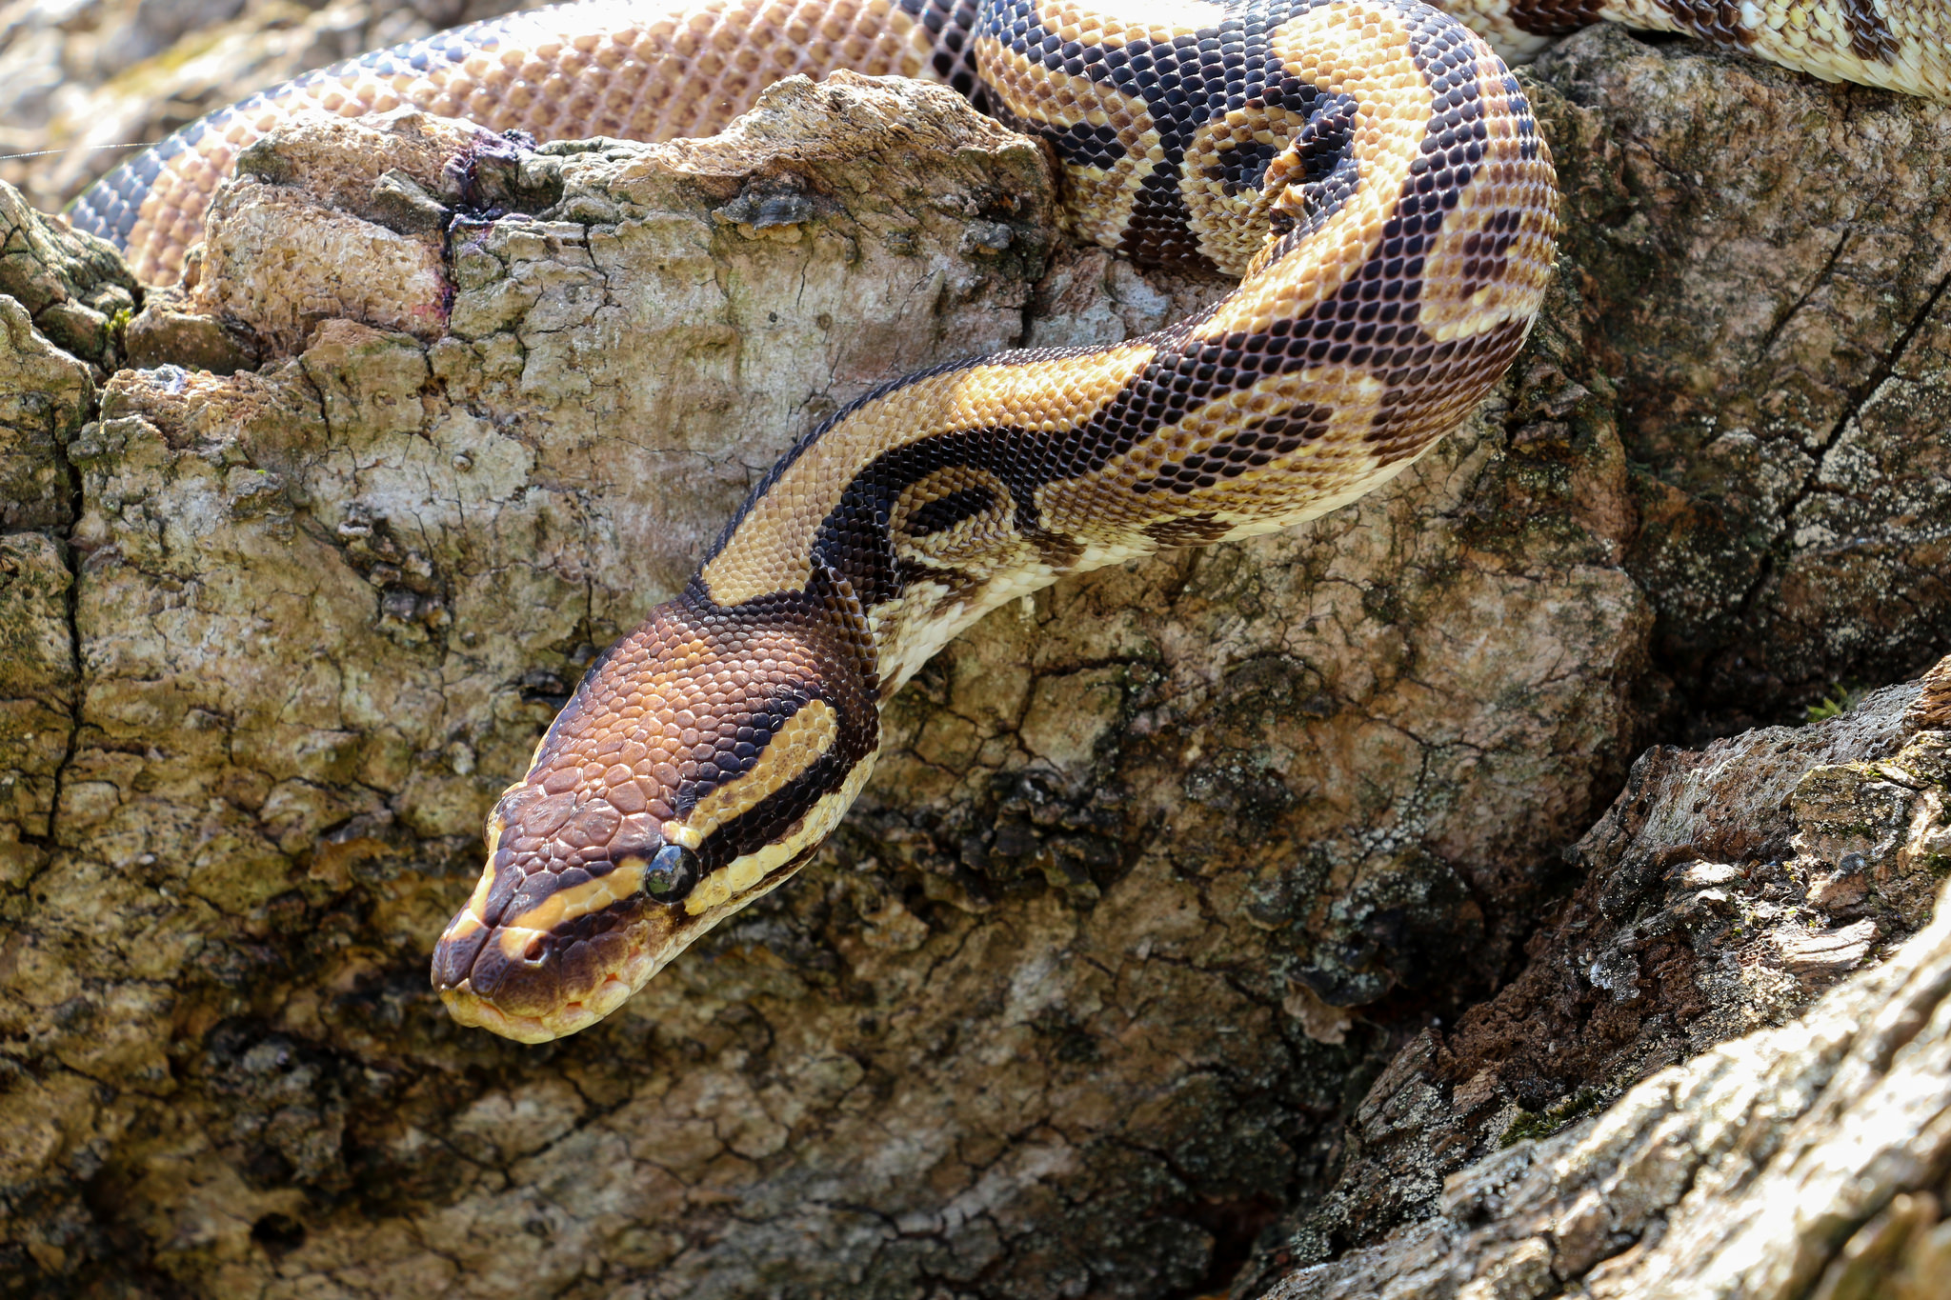
The Python's Scales
Introduction
The Encounter
Concepts
Exercise
Review
Notes:
Chris Parker @ https://flic.kr/p/oLXRTD

Slide 69
The Python's Scales
Introduction
The Encounter
Concepts
Exercise
Review
Notes:
Chris Parker @ https://flic.kr/p/oLXRTD

Slide 71
The Python's Scales
Introduction
The Encounter
Concepts
Exercise
Review
Notes:
Chris Parker @ https://flic.kr/p/oLXRTD

Slide 72
Custom Resource
A custom resource is a simple extension of Chef that is implemented as part of a cookbook. It follows easy, repeatable syntax patterns and effectively leverages resources that are built into Chef.
The result is reusable in the same way as resources that are built into Chef.
https://docs.chef.io/custom_resources.html

Slide 73
Custom Resource: action
Each custom resource must have at least one action that is defined within an action block.
https://docs.chef.io/custom_resources.html#define-actions

Slide 74
Custom Resource: property
Custom properties are defined in the resource. A property describes a field that a user of the custom resource can set when they define the custom resource within their recipes.
These properties have a type, can have default values, or be set to retrieve the value from the name of the resource.
https://docs.chef.io/custom_resources.html#define-properties

Slide 75
The Python's Scales
Introduction
The Encounter
Concepts
Exercise
Review
Notes:
Chris Parker @ https://flic.kr/p/oLXRTD

Slide 76
Exercise

Slide 77
The Python's Scales
Introduction
The Encounter
Concepts
Exercise
Review
Notes:
Chris Parker @ https://flic.kr/p/oLXRTD

Slide 78
Live Demonstration

Slide 79
The Python's Scales
Introduction
The Encounter
Concepts
Exercise
Review
Notes:
Chris Parker @ https://flic.kr/p/oLXRTD

Slide 81
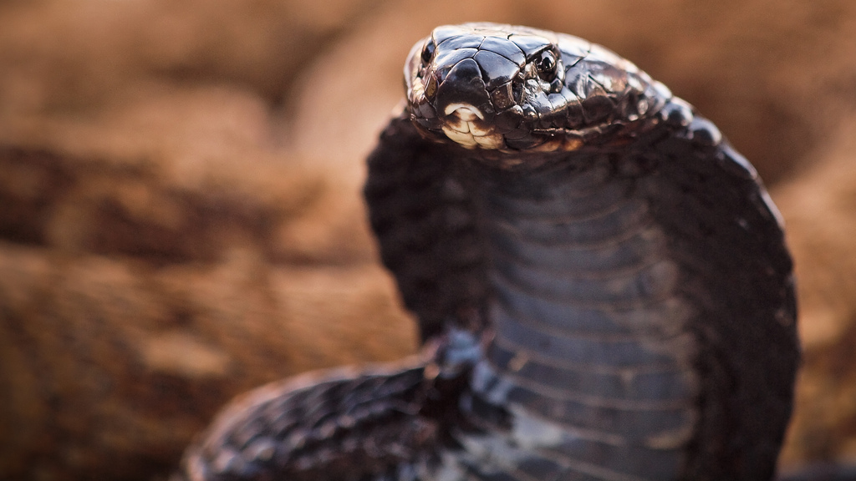
Challenging the Golden Cobra
Introduction
The Encounter
Concepts
Exercise
Review
Notes:
Luca Boldrini @ https://flic.kr/p/7wo8dk

Slide 83
Challenging the Golden Cobra
Introduction
The Encounter
Concepts
Exercise
Review
Notes:
Luca Boldrini @ https://flic.kr/p/7wo8dk

Slide 85
Challenging the Golden Cobra
Introduction
The Encounter
Concepts
Exercise
Review
Notes:
Luca Boldrini @ https://flic.kr/p/7wo8dk

Slide 86
Stubbing Search
Because ChefSpec is a unit-testing framework, it is recommended that all third-party API calls be mocked or stubbed. ChefSpec exposes a helpful RSpec macro for stubbing search results in your tests.
If you converge a Chef recipe that implements a search call ChefSpec will throw an error. You may stub the search call to prevent the error and test a variety of search results that could be returned.
https://github.com/sethvargo/chefspec#search

Slide 87
Testing Guards
Resources that employ guards will either generate an error or fail to converge during testing. To ensure that they converge the guard statement needs to be stubbed.
https://github.com/sethvargo/chefspec#command

Slide 88
Challenging the Golden Cobra
Introduction
The Encounter
Concepts
Exercise
Review
Notes:
Luca Boldrini @ https://flic.kr/p/7wo8dk

Slide 89
Exercise

Slide 90
Challenging the Golden Cobra
Introduction
The Encounter
Concepts
Exercise
Review
Notes:
Luca Boldrini @ https://flic.kr/p/7wo8dk

Slide 91
Live Demonstration

Slide 92
Challenging the Golden Cobra
Introduction
The Encounter
Concepts
Exercise
Review
Notes:
Luca Boldrini @ https://flic.kr/p/7wo8dk

Slide 94

Securing the Power of the Ark
Introduction
The Encounter
Concepts
Exercise
Review
Notes:
Andrea Kirby @ https://flic.kr/p/9h1bLJ

Slide 96
Securing the Power of the Ark
Introduction
The Encounter
Concepts
Exercise
Review
Notes:
Andrea Kirby @ https://flic.kr/p/9h1bLJ

Slide 98
Securing the Power of the Ark
Introduction
The Encounter
Concepts
Exercise
Review
Notes:
Andrea Kirby @ https://flic.kr/p/9h1bLJ

Slide 99
Helper Methods
To create more concise recipes code is often defined in methods that are stored in modules. These modules are then included within the recipe or the resources when the cookbook is loaded.
These helper methods provide an easy way to simplify, on the surface, complicated logic that may need to be calculated or retrieved from the system.
No Reference

Slide 100
Include in a Class
Methods defined within a module is portable code that can be inserted into any context that includes them. This is often done at the start of the recipe which includes the methods into the Chef::Recipe class.
This same tactic can be used within any class that you may choose to define.
No Reference

Slide 101
Stub and Mock
Generating a class for every scenario can make the code less clear to understand as it requires more boiler plate code to accomplish the goal for every specification.
RSpec provides a way to stub method calls which will allow you to more quickly setup the scenario that isolates the test and helps you express your expectation quicker.
No Reference

Slide 102
Securing the Power of the Ark
Introduction
The Encounter
Concepts
Exercise
Review
Notes:
Andrea Kirby @ https://flic.kr/p/9h1bLJ

Slide 103
Exercise

Slide 104
Securing the Power of the Ark
Introduction
The Encounter
Concepts
Exercise
Review
Notes:
Andrea Kirby @ https://flic.kr/p/9h1bLJ

Slide 105
Live Demonstration

Slide 106
Securing the Power of the Ark
Introduction
The Encounter
Concepts
Exercise
Review
Notes:
Andrea Kirby @ https://flic.kr/p/9h1bLJ

